Slide 1
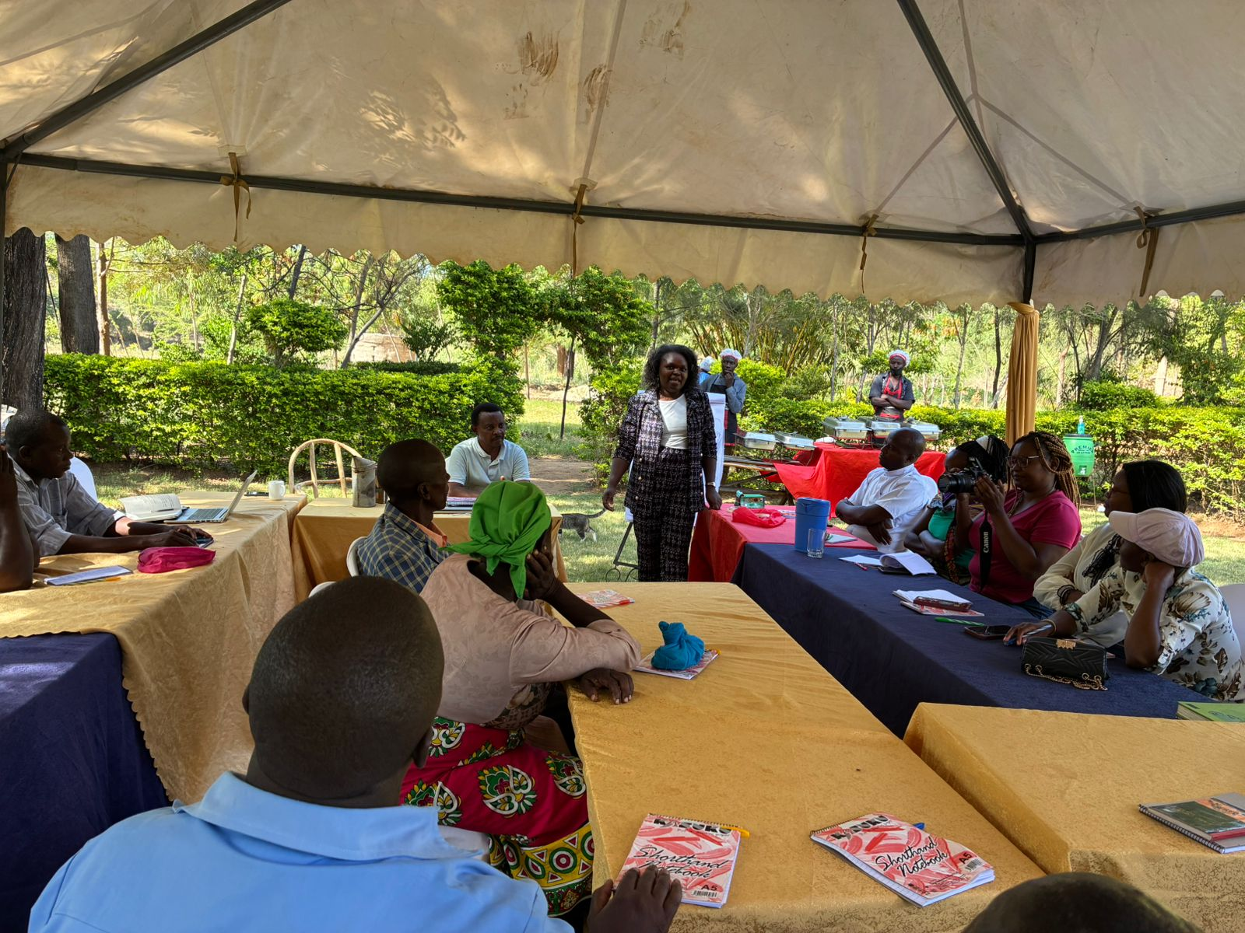
NUGAN Seminar & Networking
[Topic]
Planetary Health Through Beekeeping:
Beekeeping as a sustainable, nature-based solution for ecosystem conservation
[Speaker]
Dr. Francisca Kilonzi Program Manager, Equity Group Foundation (Kenya)
[Date and Time]
February 20 (Fri), 2026
12:00-13:00 Seminar
13:00-14:00 Networking session (with snack & coffee)
[Venue]
Yeh Kuo-Shii Global Friendship Center
This study aims to establish a model site for biodiversity and conservation through bee keeping as a sustainable, nature-based solution for ecosystem conservation in rural Kenya.
The presentation will examine the overall impact of beekeeping on environmental and biodiversity conservation, including its health, social and economic advantages through local community capacity building.
[Inquiry]
Masahiko Ota (Grad.Sch.Intgr.Sci.Tech, NU)
095-819-2731, masahikoota@nagasaki-u.ac.jp

